Slide 1
From design to estimation
Francesco Bogliacino

Slide 2
Lecture 1

Slide 3
Why this course
This is not just another course on a platform for experiments
This is a set of good practices + an introduction to JS
It is based on one key principle:
As experimentalist, we rely on the design, so we need to try to solve as many problems as possible while designing the experiment

Slide 4
Let’s start
Things to do: start a project, key information
Documentation is very important so make sure that you add title, description, and that you created a GitHub or OSF file (you may also create the Github folder and link to an OSF project via adds-on Github, choosing one folder)
Learning about some basic tabs:
Folder to upload static files
html
CSS (we will see later)

Slide 5
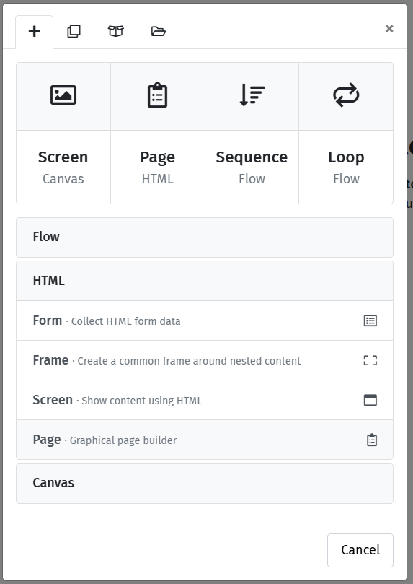
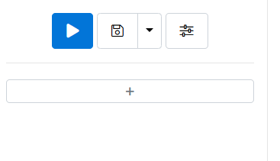
Start by a basic form
You will be asking questions. The way a web interface collects response is through a form
To introduce a form,

Slide 6
The first form
We will ask two simple questions: gender and age.
But this will be our way to learn a bit about html and css
First give a name to the form

Slide 7
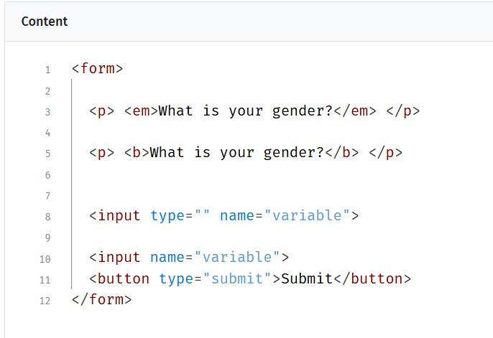
The html
Html is a markup language. You do not perform tasks and operation. It is focused on presentation;
The key concept is tag. A tag is opened and closed as <tag></tag>.
Italic and bold are controlled as tags

Slide 8
The input tag
The key tag to collect data for us will be the input tag;
The input element does not require a closing tag because it is used to create various types of form controls, such as text fields, checkboxes, radio buttons, and buttons;
There are plenty of types, so let’s learn about a few of them that are useful (https://www.w3schools.com/html/html_form_input_types.asp)

Slide 9
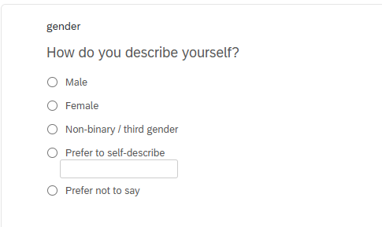
The gender question
We follow the Qualtrics validated question. We need five radio buttons and one text

Slide 10
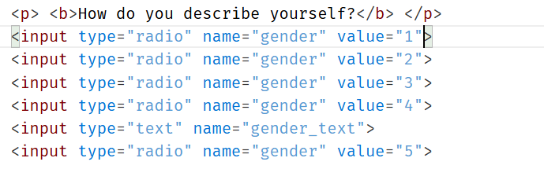
The gender question
We follow the Qualtrics validated question. We need five radio buttons and one text
Three problems
Required response
Formatting
Labels

Slide 11
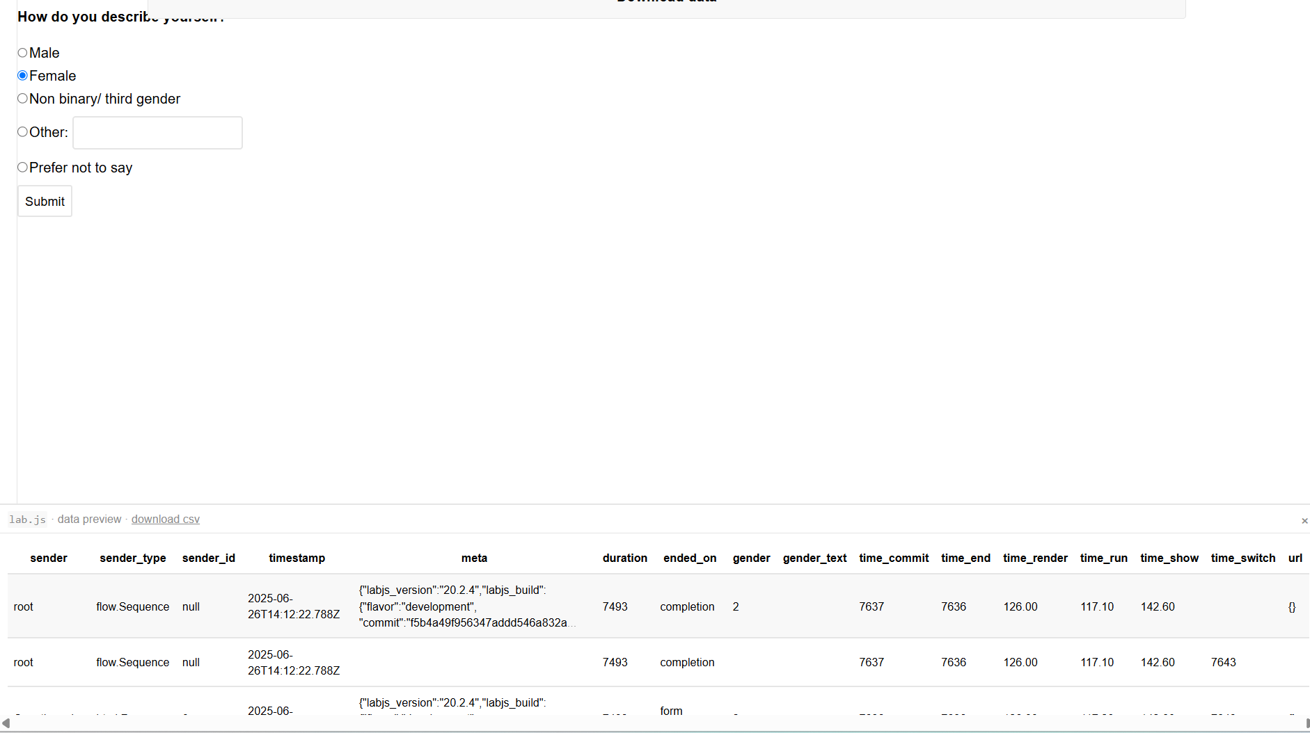
Let’s try to answer and look at the data

Slide 12
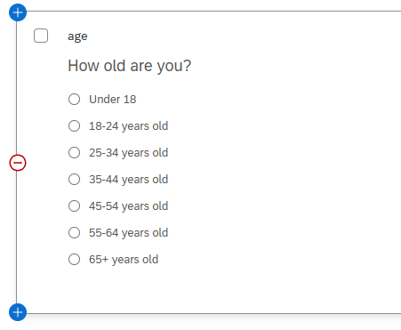
The age question
Try to implement the same question

Slide 13
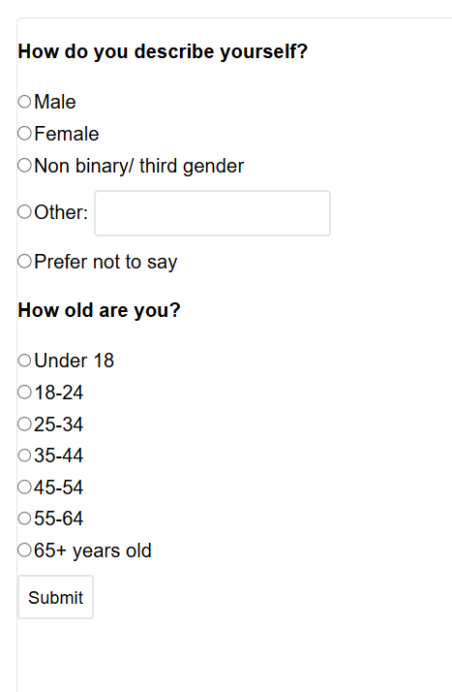



The interface is terrible

Slide 14
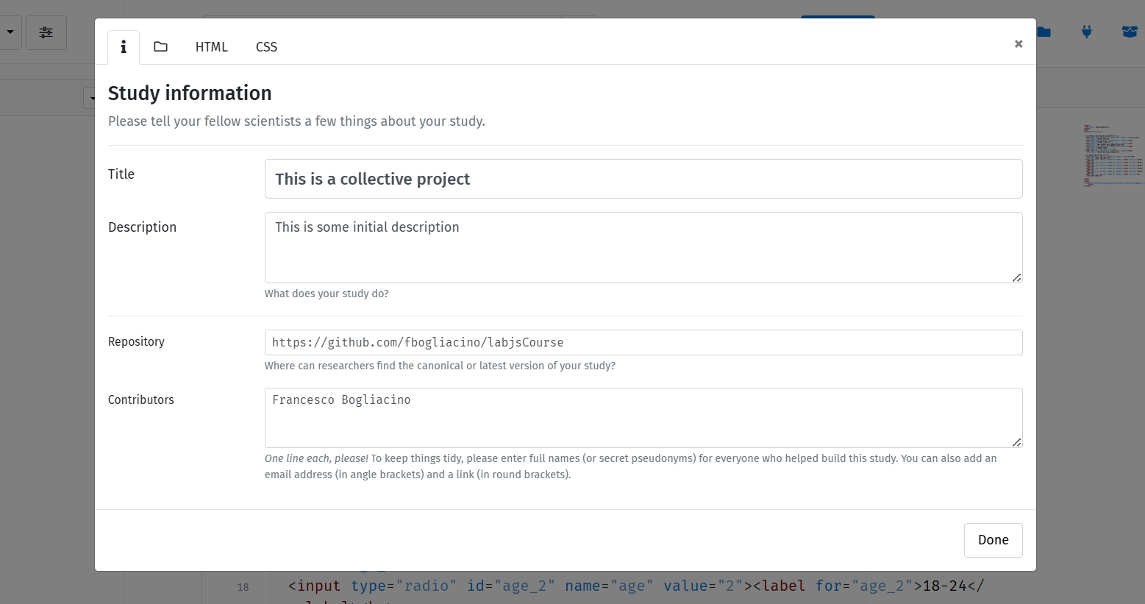
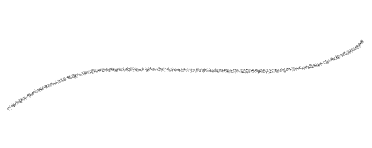


How to work in style
Notice that there is a baseline html

Slide 15














How to work in style
The key is the use of CSS. CSS is a programming language
You can typically define tags and classes in CSS
Play with some simple properties
main{
margin-left: 510px;
margin-right: 200px;
background-color: whitesmoke;
text-align: justify;
}

Slide 16
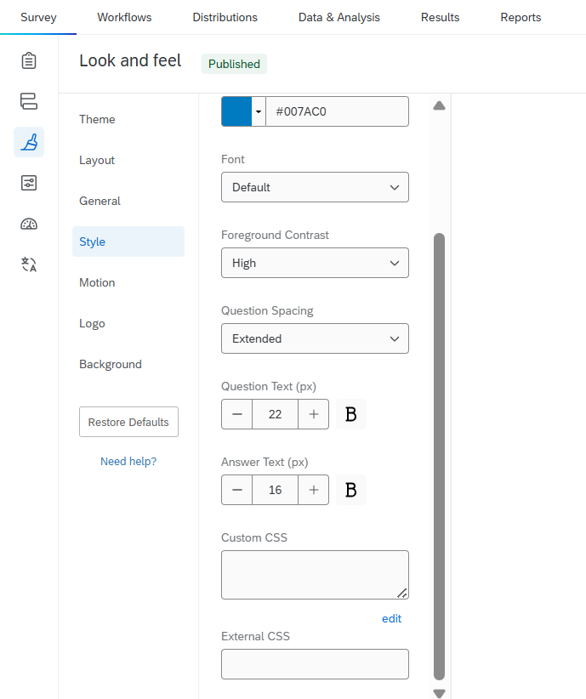




Notice: Qualtrics
You can use CSS to customize in most of experimental softwares, from Qualtrics to JATOS, from oTree to …

Slide 17
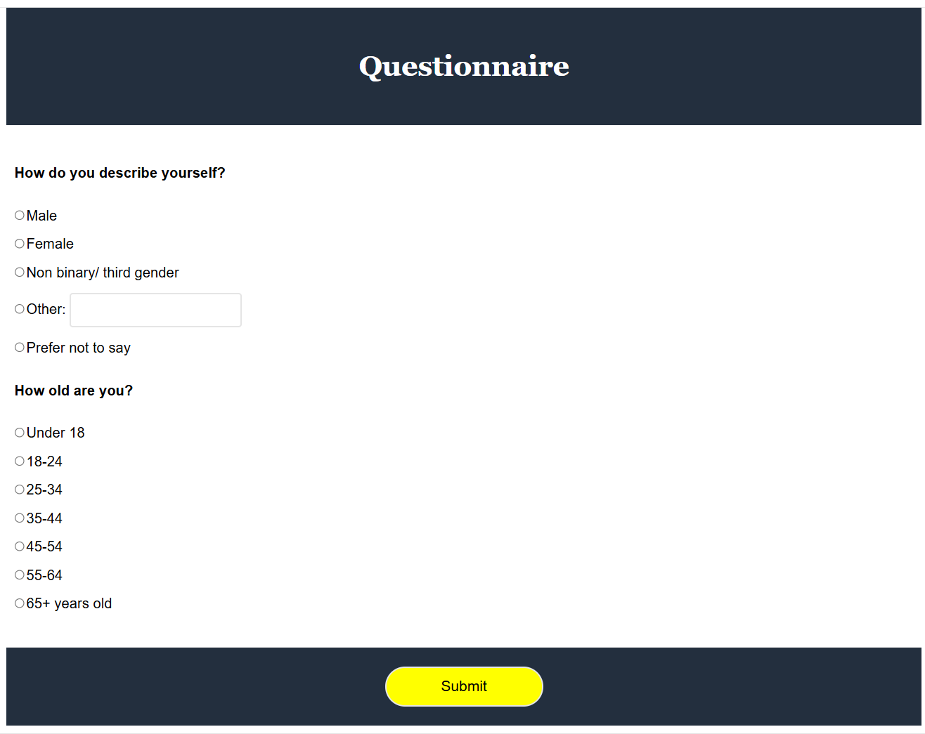

Slide 18
Lecture 2

Slide 19
Before jumping to the main task
There is a typical step you will need before starting: the informed consent
The basic ingredients of an informed consent are text and checkbox
Try a few minutes to work it out

Slide 20
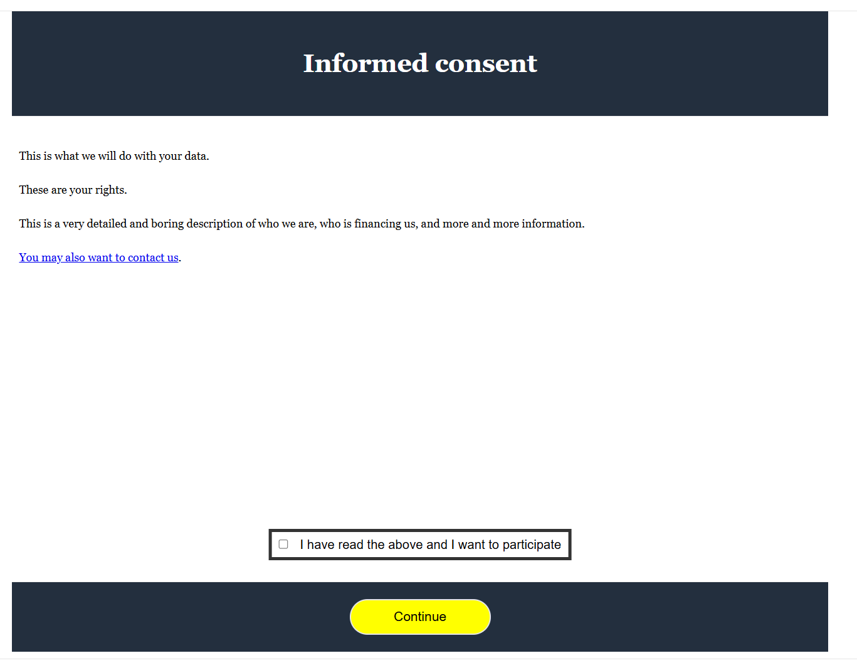
Informed consent
Remember the email contact
Check the css code

Slide 21

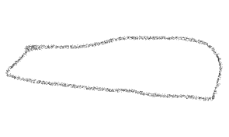
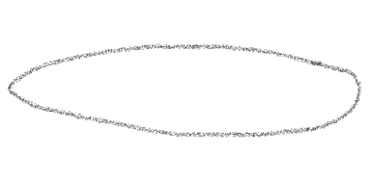
<header>
<h1 class="h1">Informed consent<h1>
</header>
<main>
<form id="informedConsent">
<p class="paragraph"> This is what we will do with your data. </p>
<p class="paragraph"> These are your rights. </p>
<p class="paragraph"> This is a very detailed and boring description of who we are, who is financing us, and more and more information. </p>
<p class="paragraph"> <a href="mailto:someone@example.com">You may also want to contact us</a>. </p>
<div class="myContainer">
<input type="checkbox" id="checkbox" name="consent" required> <label class="labelInputs" for="checkbox"> I have read the above and I want to participate </label>
</div>
</form>
</main>
<footer>
<button form="informedConsent" class="continueButton" type="submit">Continue</button>
</footer>

Slide 22
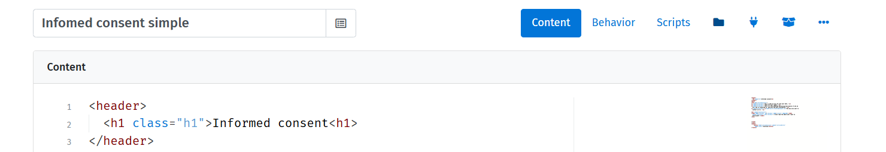

Informed consent
This format is not flexible enough (what is the IRB asked us to use a two pages IC?) and already contained too much text;
We can use the iframe tag, which allows embedding a document within the document

Slide 23
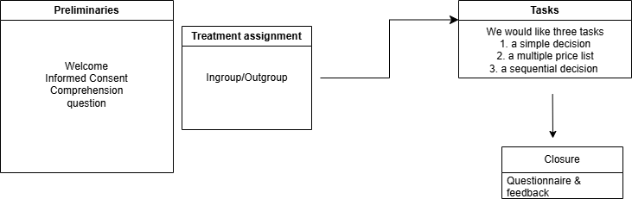
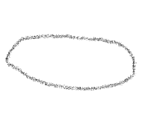










Now let’s pause for a moment
What do we want to do?
randomization
Single switch
matching
Feedback & controlling attempts

Slide 24
Lecture 3

Slide 25
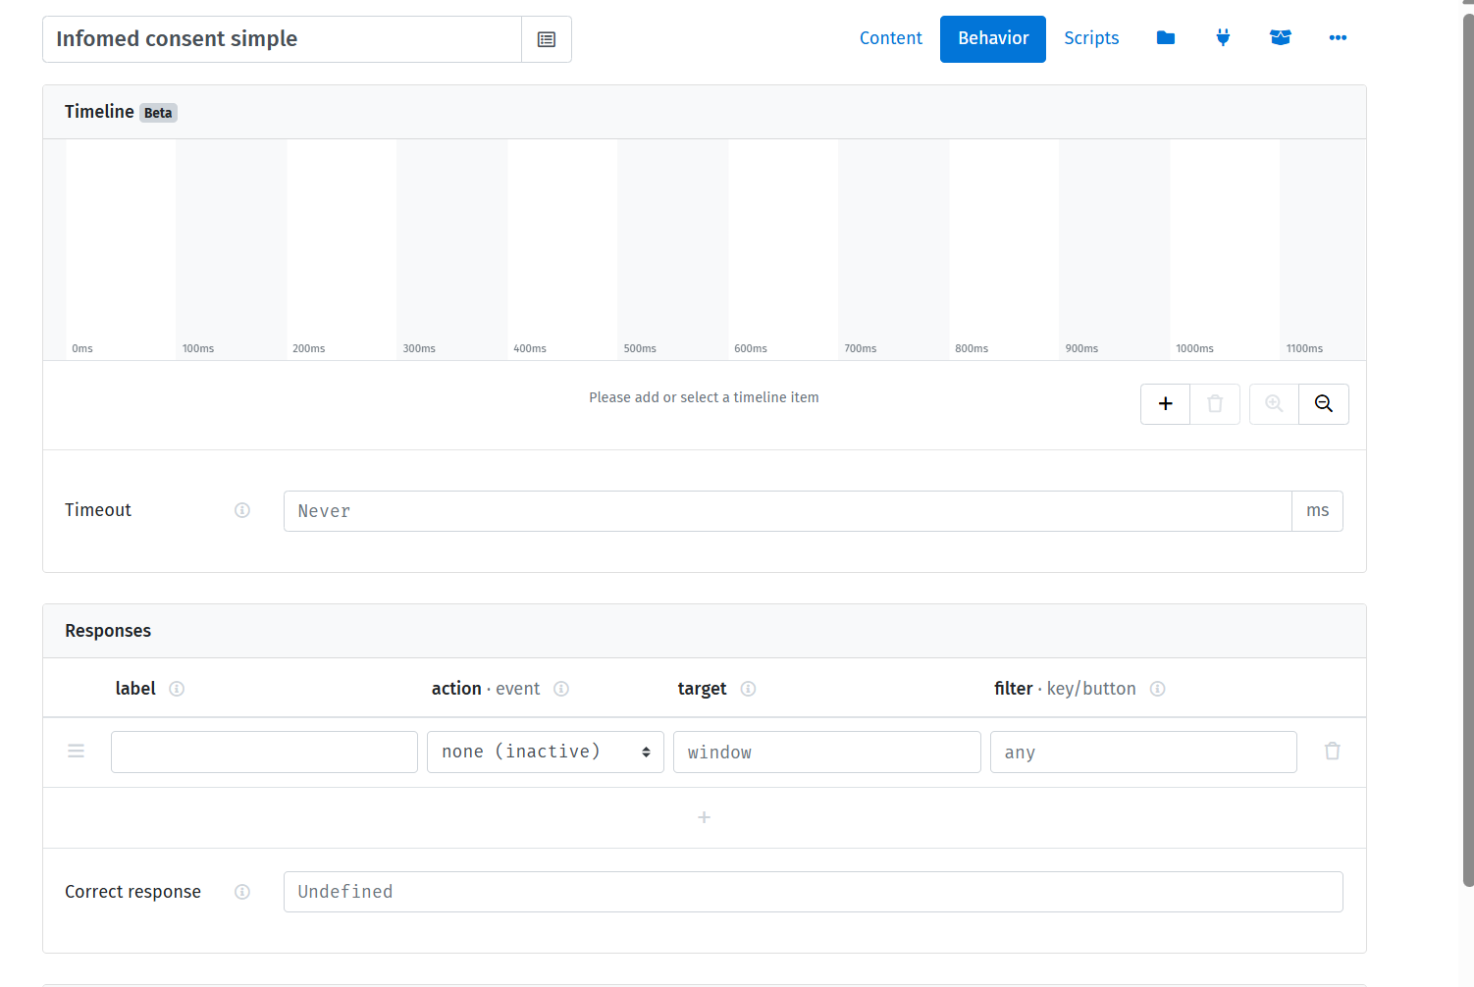
The DOM (Document Object Model) & JS
You can notice that there is a «behavior» tab that allows you to experiment with timeout, manipulate responses from the keyboard etc
But for us the most important thing is the «script» tab, which introduces us to JS language
JS language is the most important language for FrontEnd. Even though Pyton is obviously the «cool» language now, you can take advantage of JS for oTree (Lioness is JS+SQL)

Slide 26

JS
We are not going to learn JS, but I really would like to motivate you to continue working with it
The minimal concepts we are going to need:
Values (data, the units of information) in JS comes in two forms primitives & object
Let’s have a look at our code and understand some important concept

Slide 27
JS
We are not going to learn JS, but I really would like to motivate you to continue working with it
The minimal concepts we are going to need:
Values (data, the units of information) in JS comes in two forms primitives & object
Every js file is a different program. For you every «script» is a different program, so you should take that into account when you move across pages

Slide 28
JS
We are not going to learn JS, but I really would like to motivate you to continue working with it
The minimal concepts we are going to need:
Values (data, the units of information) in JS comes in two forms primitives & object
Every js file is a different program. For you every «script» is a different program, so you should take that into account when you move across pages
We can have functions (collections of procedures with input and output)

Slide 29
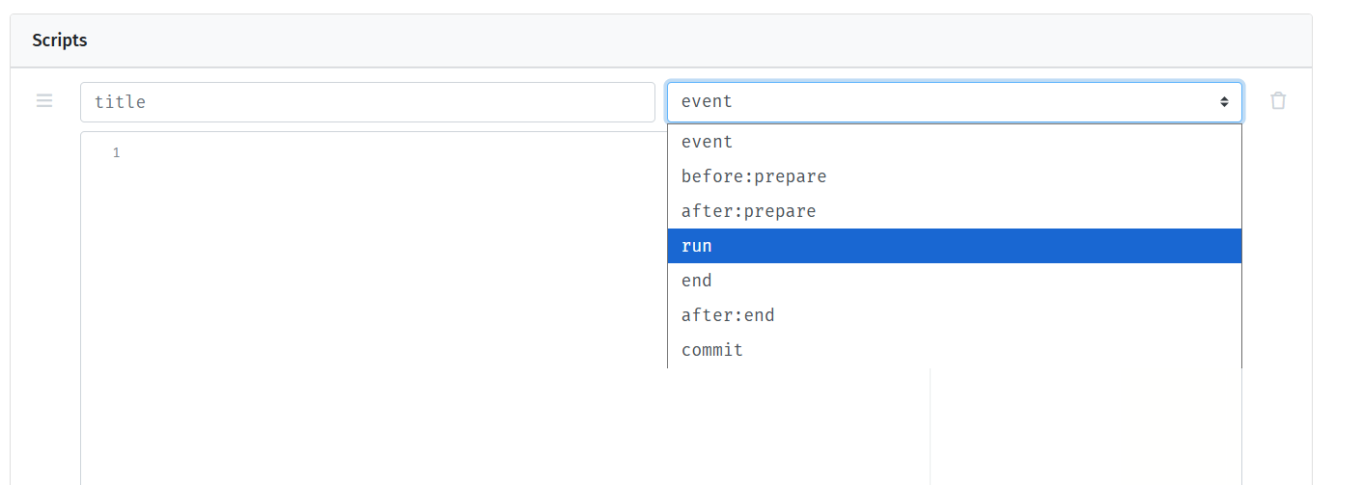
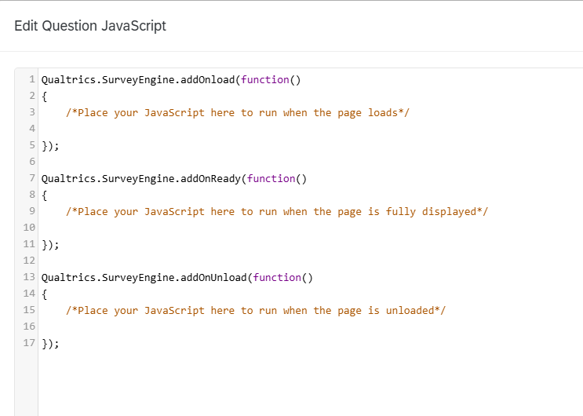
JS
Notice that you have to declare when the procedures you are writing should be executed (most of the time it’s going to be «run»)
This means that they are included into functions
Notice that there is a parallel in Qualtrics

Slide 30
How do we write the typical objects
One thing is an array
In arrays, components are ordered and have an index
Arrays’s index starts from 0 always
You may have arrays of numbers, strings, arrays, objects, …
Objects are unordered keyed collections of any values
How you recover the value?
Not by index, by the key (or property)

Slide 31
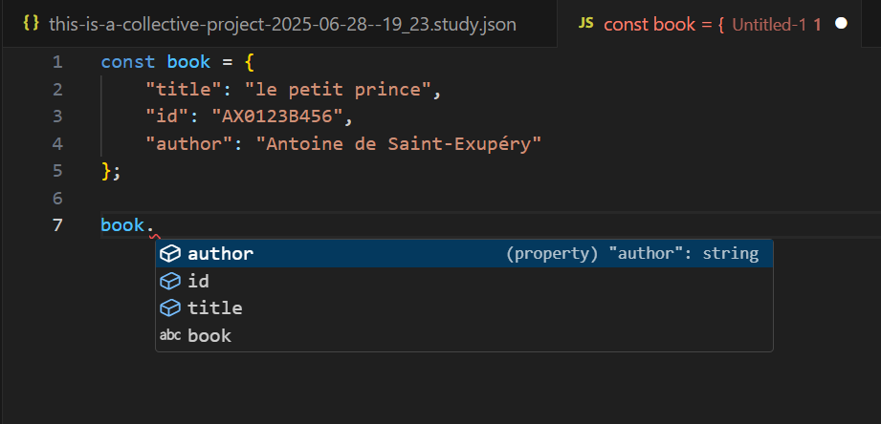
How do we write the typical objects
We can define objects are recall their properties

Slide 32
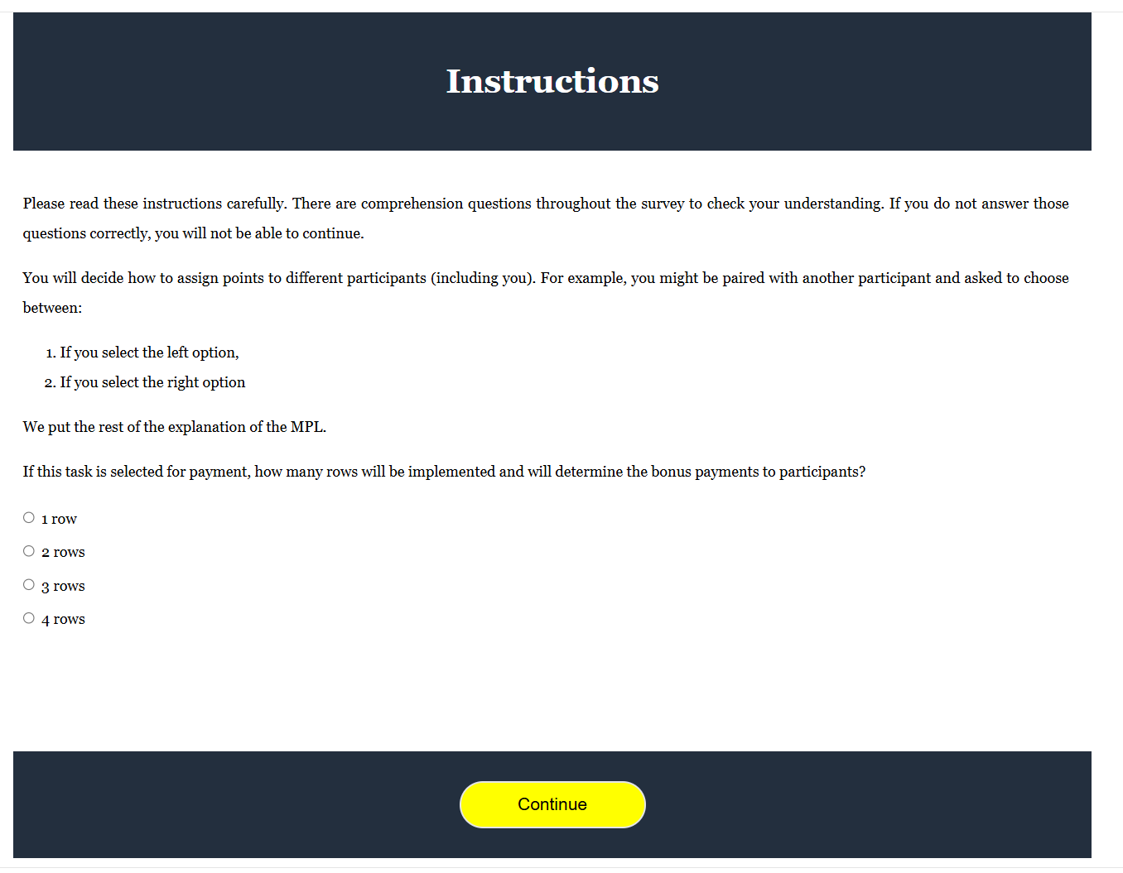


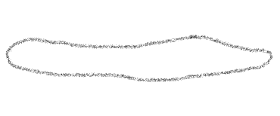
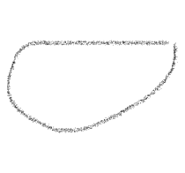


What we would like
We need some «manipulation» of the main document
This is the concept of DOM

Slide 33
Reasoning in terms of objects
We can think at «things» on the main document as objects that we want to dynamically modify
If a paragraph is an object, we would need to call it and we would like to change its content
We would need a trigger: when the participant does something (provide an answer) we alter the paragraph to provide the response

Slide 34
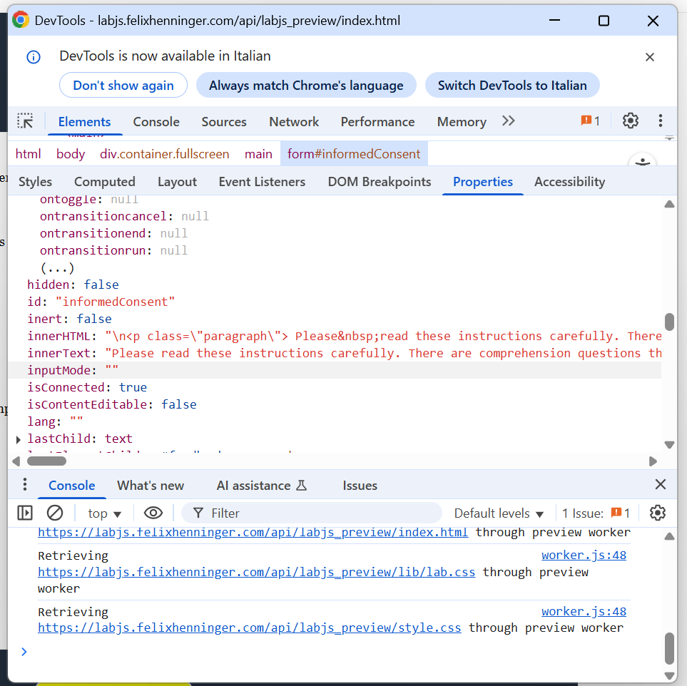
Learning and debugging
One way to learn about the structure of the DOM is through the dev tools of your browser
Notice that there is a console. The console is perfect for debugging

Slide 35
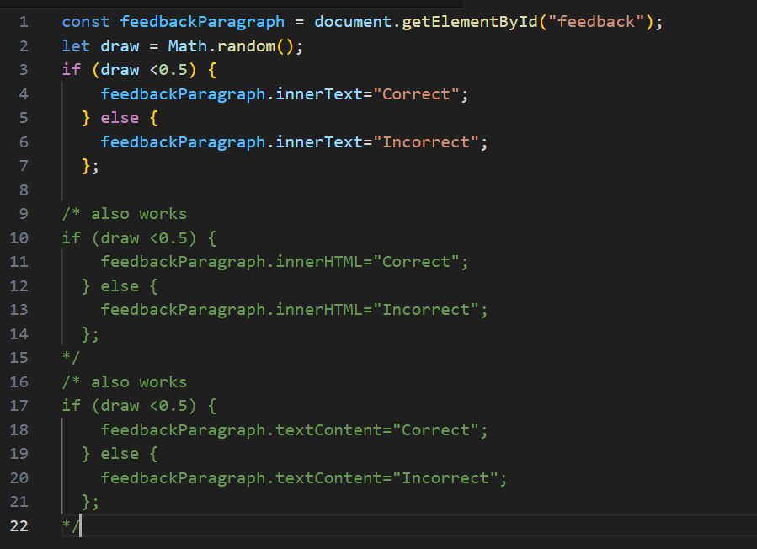
Manipulation of the DOM
We have variable declaration (const/let/var);
We have the use of some methods (Math.random())
We are manipulating some properties

Slide 36
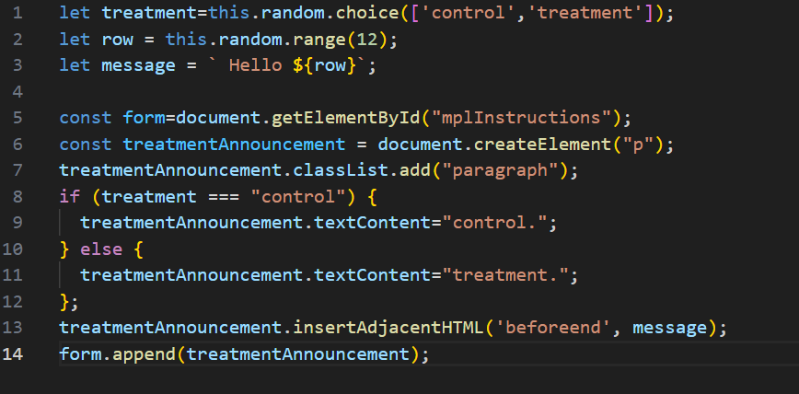
Manipulation of the DOM
Careful on comparisons. In JS these can be nightmares
===
==
But careful also with < and >

Slide 37
Lecture 4

Slide 38
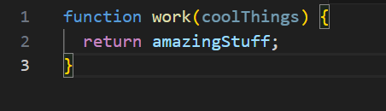
The trigger
The addEventListener() method of the Event’s Target interface sets up a function that will be called whenever the specified event is delivered to the target;
We need to generate a function (a set of instructions);
The normal way to generate functions is through a function declaration

Slide 39
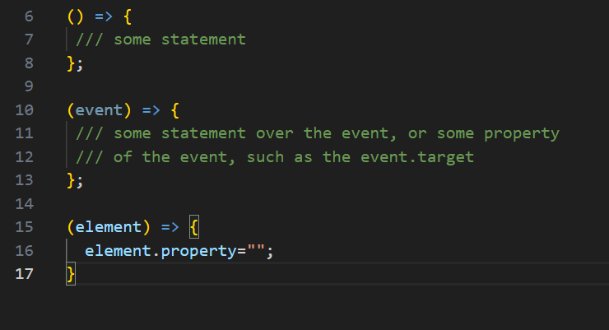
The trigger
However, most of times, you can work with simple function declarations, called arrow functions

Slide 40
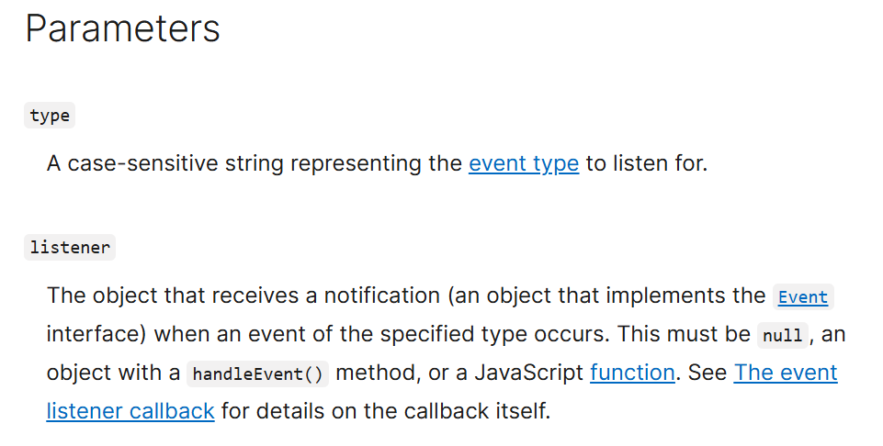
addEventListener
We need to specify the event and the function that we want to implement

Slide 41
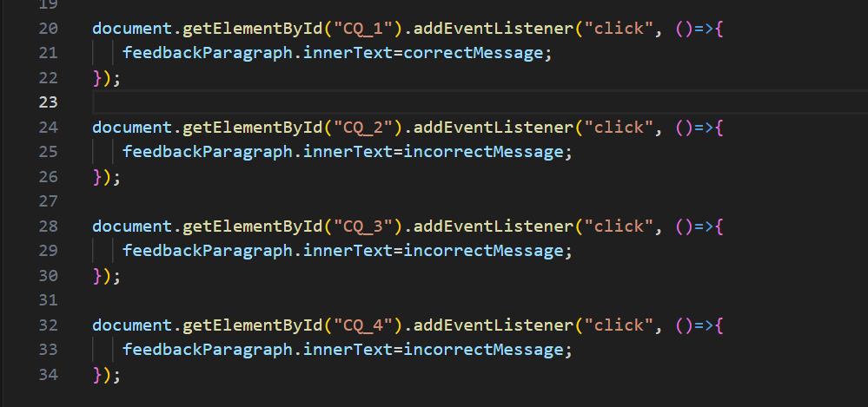
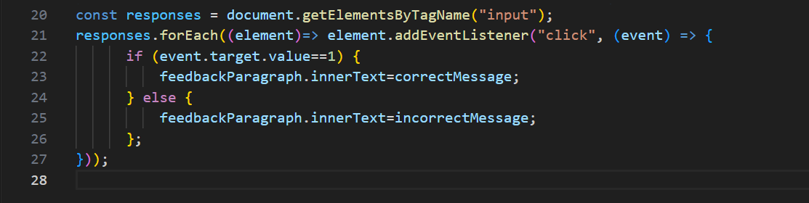
Re-factorize the code

Slide 42
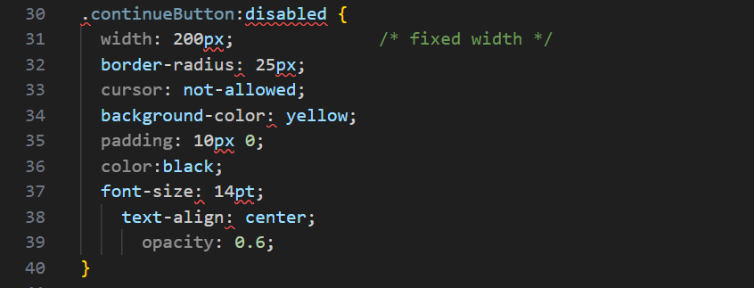
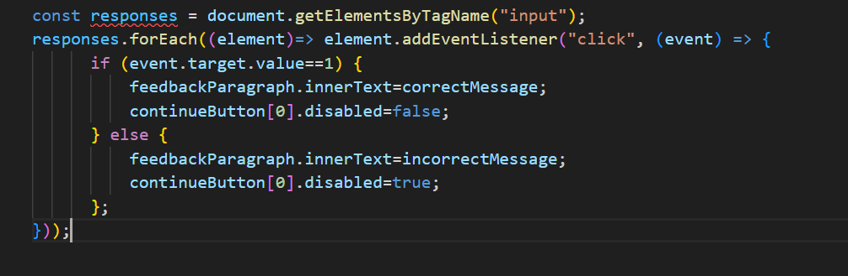
Further step: dynamically adjust the button

Slide 43
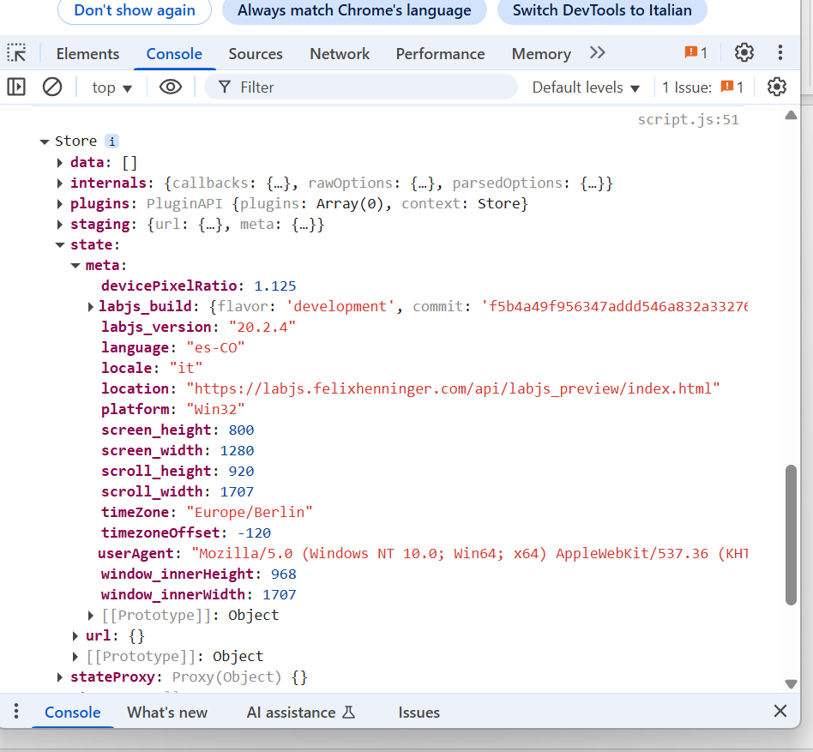
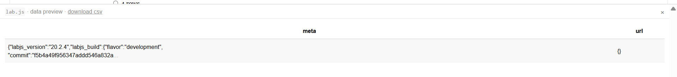
Further step: adding the attempts
let ds=this.options.datastore;
console.log(ds);

Slide 44
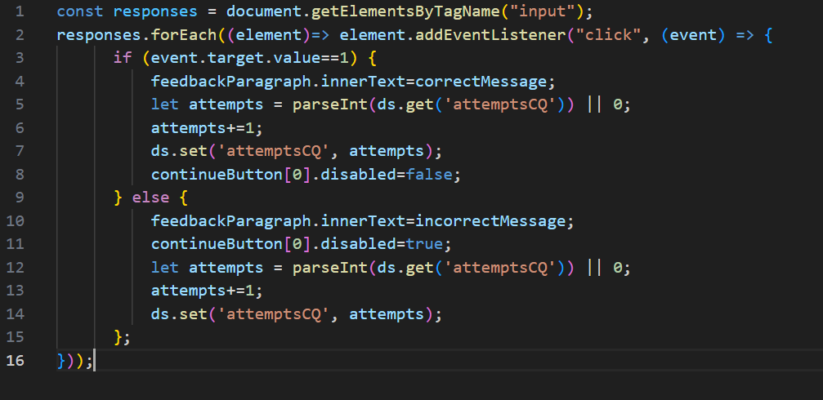
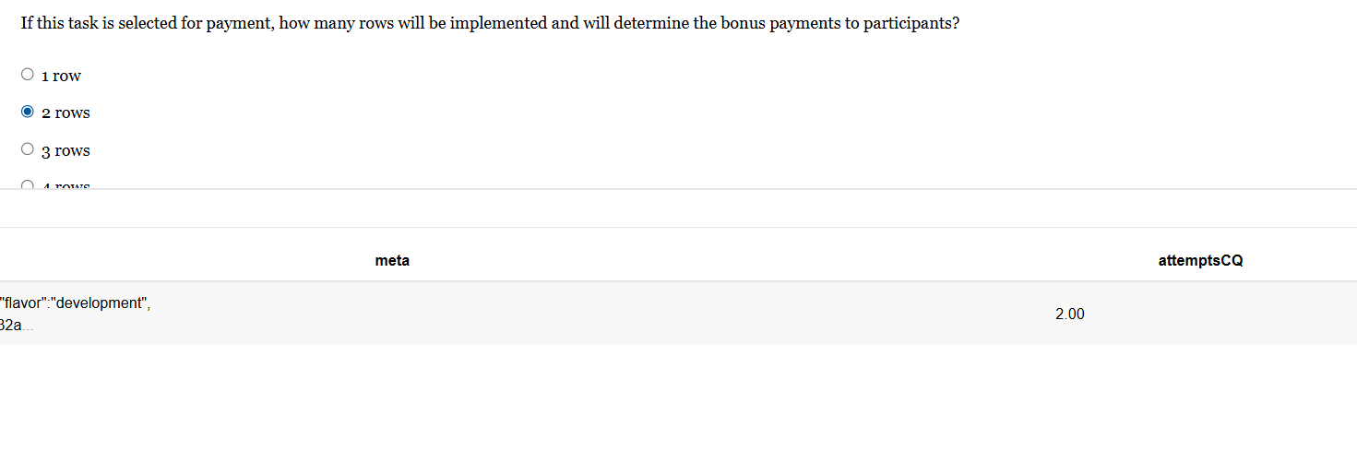
Showing the data collection

Slide 45
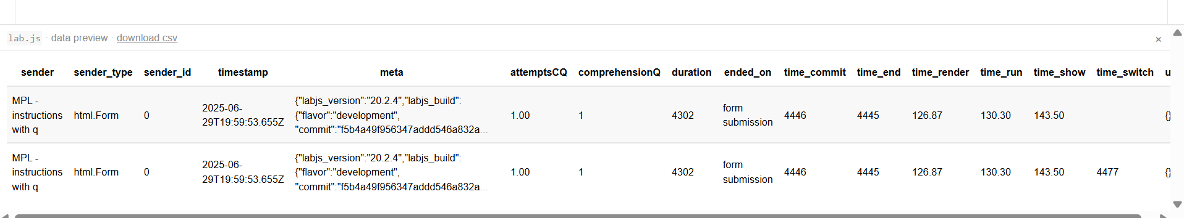




The data structure
While the code is executed, you have the state
Notice the «sender»: the database is «long», with each page playing the role of a «t» [as a «panel»]

Slide 46
Lecture 5

Slide 47
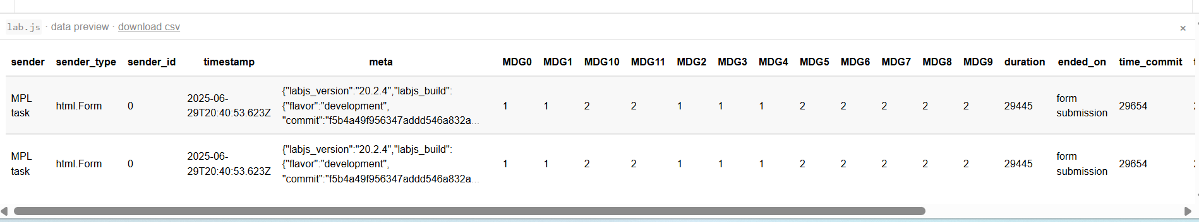
Completing the task for MPL
We can build a Table within a div environment
We need to introduce CSS elements
We use radiobuttons for each row of the MPL

Slide 48
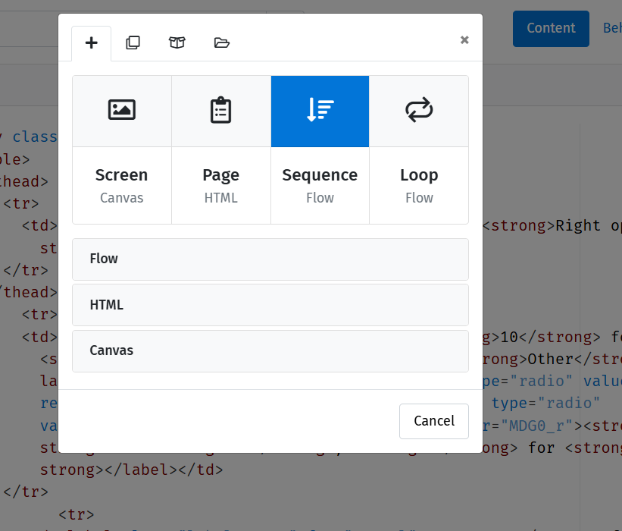
Introducing a sequence
We can group together the MPL task

Slide 49
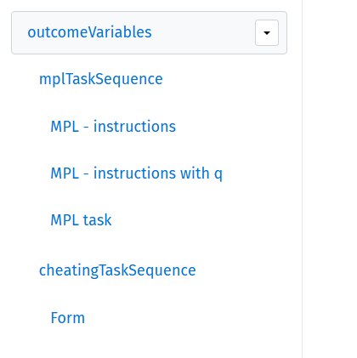
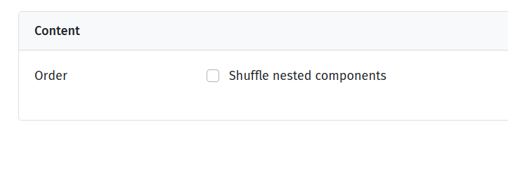
Using the sequence object
The sequence creates a group of pages
The equivalent in Qualtrics is the «group» object in SurveyFlow

Slide 50
The Loop
The other key sequence tool is the loop.
We will see how it works in the context of the treatment assignment

Slide 51
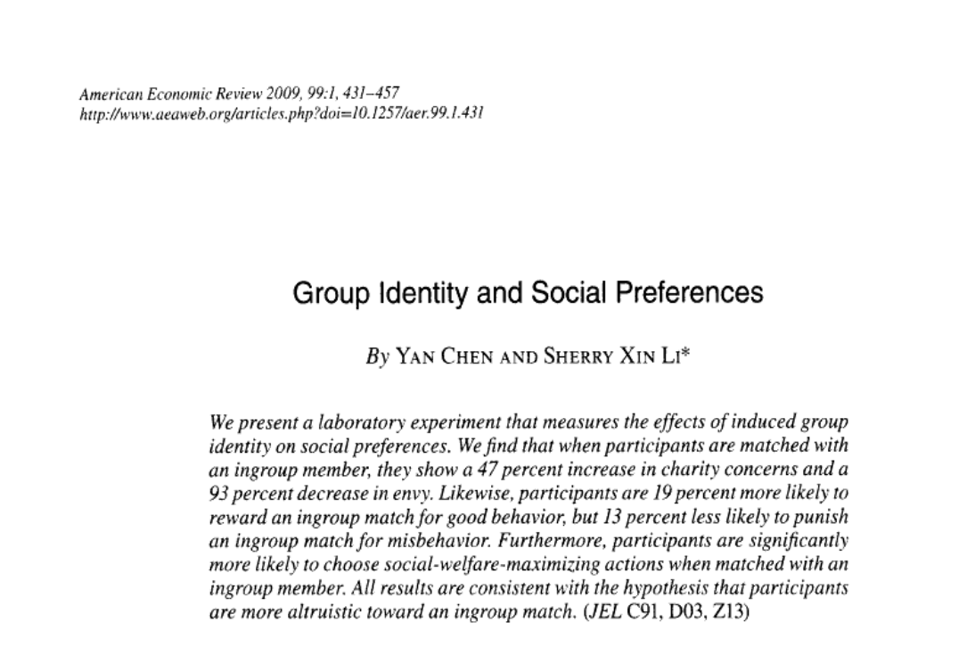
The Loop
We can manipulate social identity using the art preferences task by Chen and Li
Requirements:
A Table, with two pictures and two buttons
A loop of five rounds
We need to keep track of choices so that we are able to distinguish those who select left/right most of the times

Slide 52
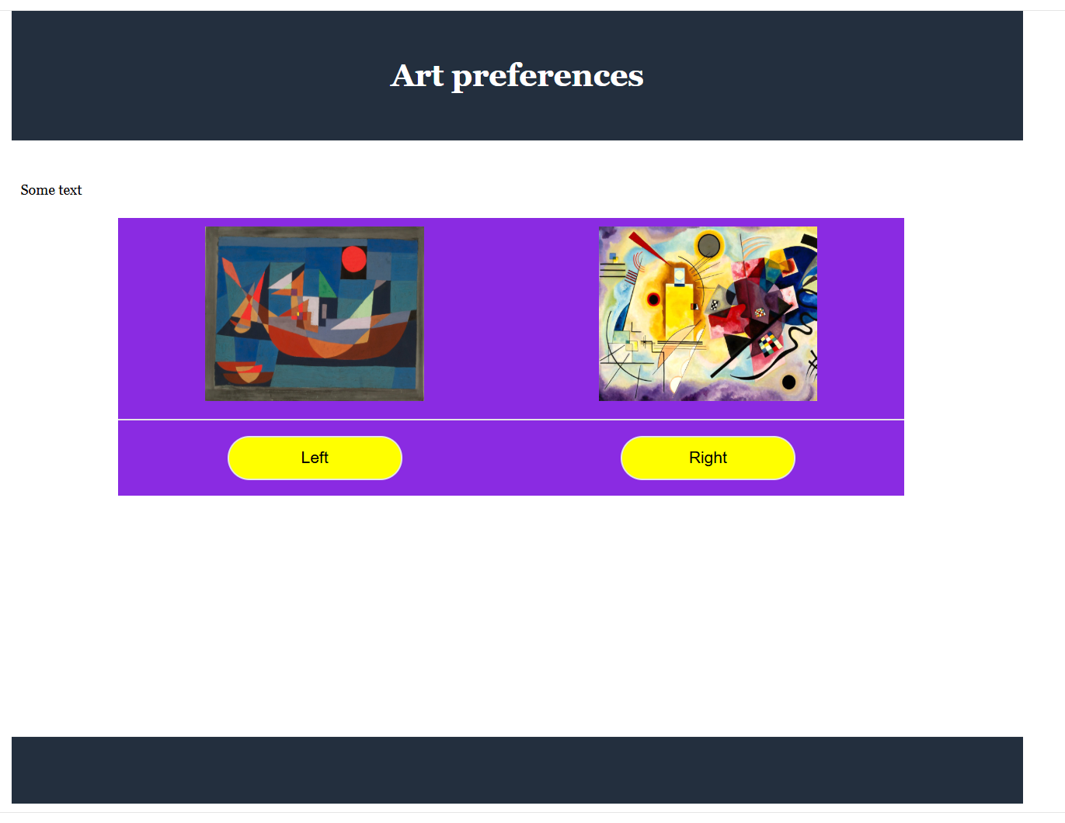





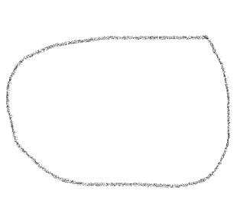

loop
choices

Slide 53
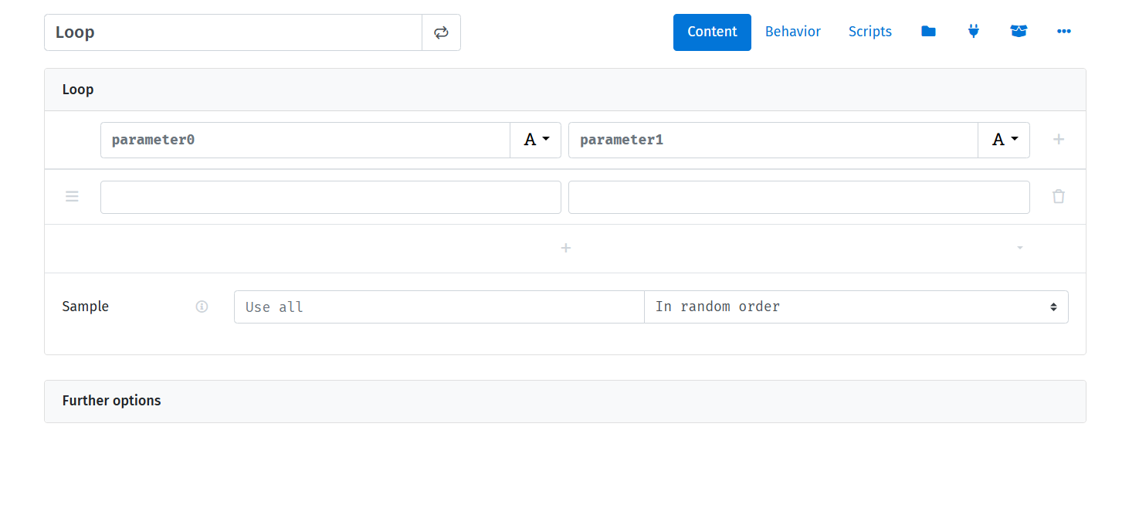

Slide 54
[just to have them ready]
https://www.bellasartes.gob.ar/media/uploads/coleccion/7966.jpg
https://www.3minutosdearte.com/wp-content/uploads/2018/09/Klee-Magia-de-los-peces-1925-e1633369586262.jpg
https://es.wahooart.com/Art.nsf/O/8XYQN9/$File/Paul-Klee-Landscape-with-Yellow-Birds.jpg
https://www.artmajeur.com/medias/mini/t/o/tony-rubino/artwork/15522313_klee-burggarten-1919-painting-in-high-resolution-by-paul-klee-original-from-the-kunstmuseum-basel.jpg
https://image.invaluable.com/housePhotos/ROGALLERY/49/736249/H4175-L309842541.jpg
https://www.biografiasyvidas.com/biografia/k/fotos/kandinsky_4.jpg
https://upload.wikimedia.org/wikipedia/commons/f/f0/Vassily_Kandinsky%2C_1923_-_Circles_in_a_Circle.jpg
https://cdn.pixabay.com/photo/2021/05/24/20/36/wassily-kandinsky-6280547_1280.jpg
https://www.artmajeur.com/medias/standard/a/d/administrator/blog/6448f069731476.45206248_wassily-kandinsky-composition-7.jpg
https://www.nacion.com/resizer/I265CujoyKVOSEa7IStTSuNqm5s=/1440x0/filters:format(png):quality(70)/cloudfront-us-east-1.images.arcpublishing.com/gruponacion/CW7JQBRSA5HVVETEJVN3HVRIC4.png

Slide 55
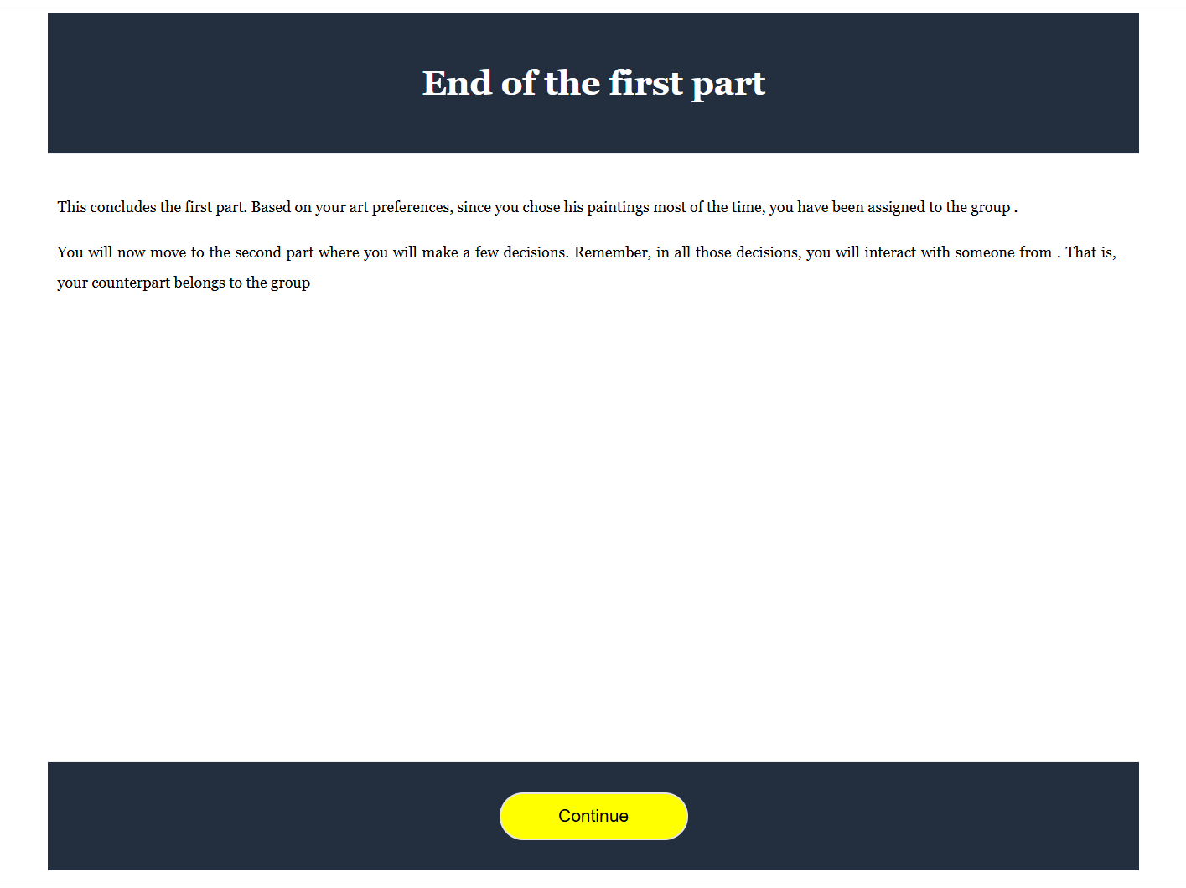



We add tags to dynamically adjust the text

Slide 56
Lecture 6

Slide 57

Single switch
We have this MDG which is an MPL
Especially for online exp, you can end up with multiple switch because of tiredom, lack of attentions etc
We can force single switch, especially if we measure multiple things (see Econographics)

Slide 58
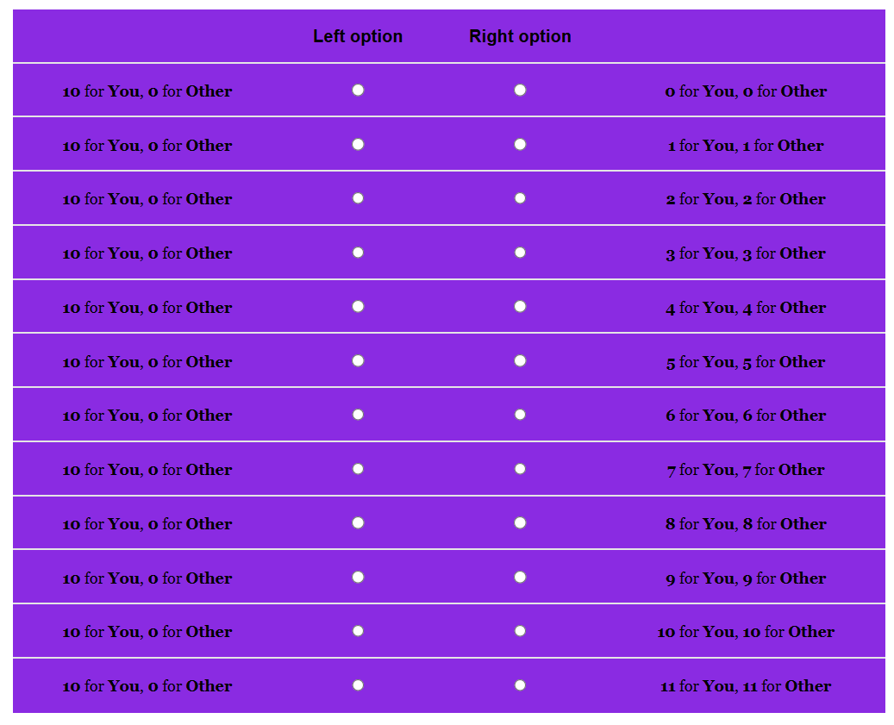
Single switch
Every time a left is selected, left is selected above and right below.
Every time right is selected, right is selected below and left is selected above
It should works at the extremes.

Slide 59
Action plan
Add a class to make sure you select all the radiobuttons (and make them as you like)
Select all them twice:
One loop will add the event listener;
One loop in forward direction will select on the right
One loop in backward direction will select on the left
We need to figure out the complicate cases

Slide 60
One final thing: data
We would like avoid having tons of variables for each row. Instead, one single variable with the switching point
When the decision is taken and the button is pressed, we record the final choice

Slide 61

Asyncronous matching
Assume that our last task is trust a la C&D
We have collected our trustees decisions
Perhaps we even have the promises

Slide 62

Asyncronous matching
We need to manage the matching
We need dynamic text for the promise
Ideally, we should match just once

Slide 63

Asyncronous matching
We need matrices of choices, ids, promises
We need a random mechanism
We need to keep track of used indices

Slide 64

Asyncronous matching
What is the problem?
The randomization

Slide 65

Asyncronous matching
One solution. But not really
We need to manage this from the server…
This is a general problem, I want to talk about that in the end

Slide 66
Asyncronous matching: general considerations
In real time interaction, you will have a web socket (or similar protocol)
With other communication protocols (such as HTTP) you need to be able to determine exactly the queuing position and be able to manage that in the system (at the moment in which the subject enters the program, i.e. this is the problem with Qualtrics)
My suggestion is to manage this via OpenLab (things are easier if you know how to manage a server in AWS)

Slide 67
Lecture 7

Slide 68

Let’s collect data locally

Slide 69

The structure of the data

Slide 70

The structure of the data
The data come in long form, as a panel
The «row» indicator is the «sender», the webpage who sent the data
This automatically collects a number of important information on time
Whether you like the panel structure or not depends on you research question, but you can work to collapse the info (more on this later)

Slide 71

Steps for integration
You can extract the program to be deployed online
You need to provide an url (where you host the study)
You need to collect the data (you need a database)

Slide 72

Examples: Qualtrics
Open a free account on Netlify.com and drag and drop your study
You will get an url for your study (change the name, it’s usually funny, nerdy, and with a lot of experimenter demand)

Slide 73
In Qualtrics
Create a text question, and control the study as an iframe object
Create an embedded data field to collect the data (Qualtrics is then responsible to collect the data and returns them in .json)
Notice: you may also want to develop the tough part in lab.js and then implement the JS code in Qualtrics

Slide 74

OpenLab
There are several options which allows a direct integration with lab.js
The most user friendly is OpenLab

Slide 75
Open Lab
Let me show simply how it works
You set up the task. This is fully integrated with lab.js, so just upload the json file
You setup a study (number of studies depends on the account)

Slide 76

Randomization setup

Slide 77

Randomization setup

Slide 78

Change in the code
Careful, the sequence should be built transferring the components from the last to the first
We need to properly update the code to detect the «treatment» and «index» from the parameters

